Slide 1
WELLCOM TO OUR CLASS
Teacher : Tran Van Chanh

Slide 2
UNIT 12 : A VACATION ABROAD
Lesson : LANGUAGE FOCUS

Slide 3
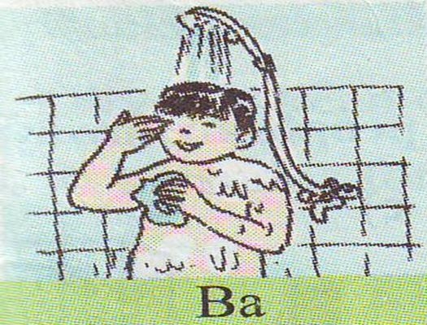
I. Past progressive.
What was Ba doing at 8 o’clock ?
→ Ba was taking a shower at 8 o’clock last night.

Slide 4
Example :
Ba was taking a shower at 8 o’clock last night.
Was
+
V-ing
S
I He She It + was + V-ing
We You They + were +V-ing
☞ Form :
Use :
Dùng để diễn tả hành động đang xảy ra tại một thời điểm xác định trong quá khứ.

Slide 5
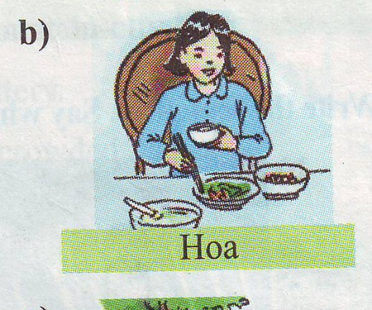
Exercise1 : Look at the pictures. Say what each person was doing at eight o’clock last night.
At eight o’clock last night.
Ba was taking a shower
Hoa was eating dinner

Slide 6
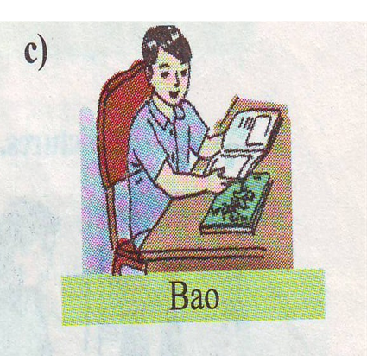
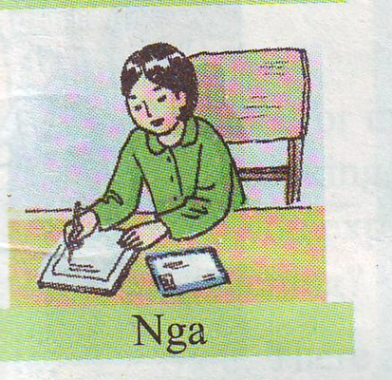
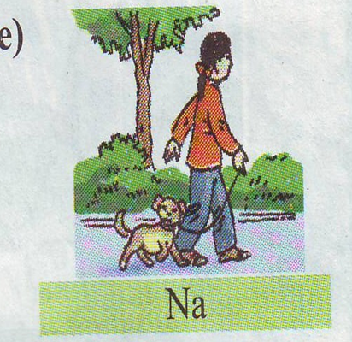
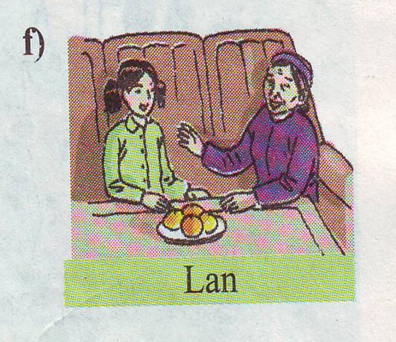
Bao was reading a comic
Nga was writing a letter
Na WAS walking with her dog
Lan was talking with her grandmother

Slide 7
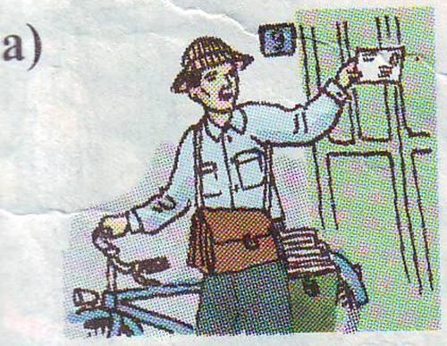
II. Past progressive with “ when” and “while”.
Who came while the Le family was sleeping ?
→ The Le family was sleeping when the mailman came.

Slide 8
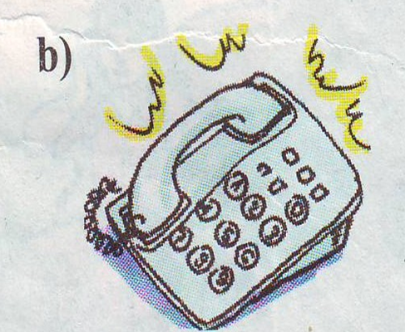
What happened whlie Nga was eating ?
→ The telephone rang while Nga was eating.

Slide 9
Examples :
The Le family was sleeping when the mailman came .
Was
+
V-ing
when
Vpast
☞ Form :
when + S + past simple
The telephone rang while Nga was eating.
Vpast
while
Was
+
V-ing
☞ Form :
while + S + past progressive
☞ Form :

Slide 10
Use :
Dùng để diễn tả hành động xảy ra trong quá khứ khi một hành động khác xen vào ( khi…..đang…..thì bỗng)
Exercise2: Look at the pictures. Then match the haft-sentences in column A to those in column B. Write the full sentences in your exercise book .

Slide 11
A
B
a. The Le family was sleeping
A. when the plane got to HN.
b. While Hoa was eating
B. when Tuan arrived came.
c. When Nam won the race
C. when the mailman came.
d. Mrs. Thoa was cooking
D. the school drum was sounding
e. When Lan arrived at school
E. the crownd was cheering.
f. It was raining
F. the phone rang.

Slide 12
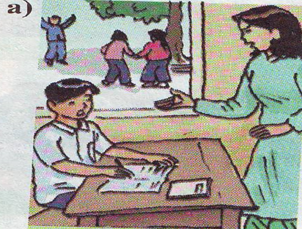
III. Progressive tenses with always.
What is Bao always doing ?
→ Bao is always forgetting his homework.

Slide 13
Example :
Bao is always forgetting his homework.
be
+
always
+
V-ing
☞ Form :
Is/am/are + always + v-ing
Use :
Diễn tả sự phàn nàn.

Slide 14
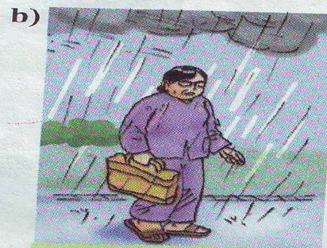
Exercise 3: Look at the picture. Write the sentences. Say what the people are always doing.
Bao/forget/homework
Mrs.Nga/lose/umbrellar
Bao is always forgetting his homework
Mrs.Nga is always losing her umbrella.

Slide 15
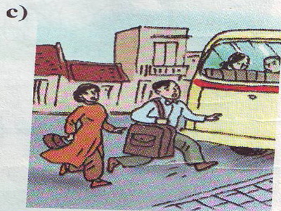
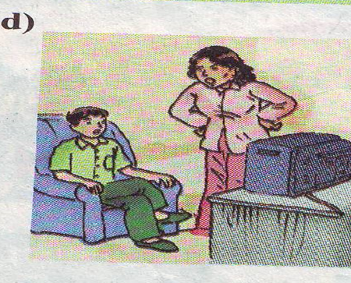
Mr. and Mrs.Thanh/miss/bus
Nam/watch/TV
Mr. and Mrs.Thanh are always missing the bus
Nam is always watching TV

Slide 16
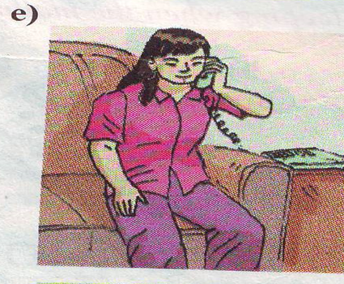
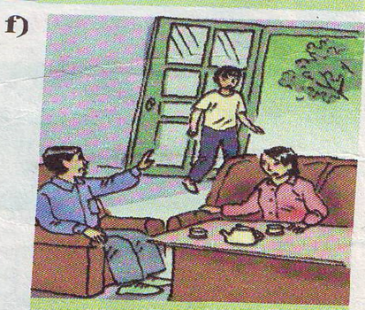
Na/ talk/ phone
Liem/go/ out
Na is always talking on the phone.
Liem is always going out.

Slide 17
❖ Put the verb in parentheses in correct form.
was walking
1. I (walk)………………………to school at 6.30 yesterday morning.
were watching
2. They (watch)……………………….TV at 9 o’clock last night.
came
3. When he (come)…………to my house yesterday, I (listen)……………………..to music.
was listening
am
going
4. I…………always (go)…………..to school late.
cooked
5. My mother (cook)……………while I (sleep)……………………
Was sleeping

Slide 18
Homework :
☺. Remember some structures.
☺. Write exercises in the notebook.
☺. Do exercise 6 on page 74 in student’s book.
☺. Prepare unit 13.

Slide 19
Thank you for your listening
Goodbye ! See you again

